Slide 1


Peekaboo: A Hub-Based Approach to Enable Transparency in Data Processing within Smart Homes
By Haojian Jin, Gram Liu, David Hwang, Swarun Kumar, Yuvraj Agarwal, Jason I. Hong
Published: 2022 IEEE Symposium on Security and Privacy
Presented By Nidhi Hegde and Shreya Reddy Katanguru

Slide 2


Overview
FUTURE WORK AND LIMITATIONS
RELATED WORK AND DISCUSSIONS
SOLUTION: PEEKABOO
DESIGN OVERVIEW
CURRENT CHALLENGES IN DATA PRIVACY
IMPLEMENTATION
ASSUMPTIONS AND BENEFITS
PEEKABOO VS FIREWALL

Slide 3

Current Challenges in Data Privacy
AGGREGATED DATA COLLECTION AT SOURCE
Example: Smart TV data collection may reveal unwanted personal information.
Android/Google app permission system is binary all-or-nothing access.
VALIDATE THE DATA COLLECTED
Edge devices, communication and backend servers are all blackboxes.
Only way to verify is Reverse Engineering.
Notes:
Imagine a smart TV developer wants to know how engaging the device is, they most likely collect user's entire watching history. It might reveal whether user is at home or not, his activity routine, his interests.
2. For instance, an app developer might need to access SMS messages from just one phone number for two-factor authentication, but Android only offers access to all SMS messages or none. One solution is to offer many fine-grained permissions for every potential use case, but this would lead to an explosion of permissions.

Slide 4

Solution: Peekaboo
Peekaboo is a privacy- sensitive architecture for the developers to use while building smart home apps.
The three characteristics that sets it apart from the traditional architecture are:
developers to explicitly declare desired data collection behaviors in an application manifest which is text based.
Developers should choose from a small and fixed set of operators which minimize the data based on requirements before sending it to the cloud.
In-home trusted Peekaboo hub, mediates between all devices in the home and the outside Internet.

Slide 5

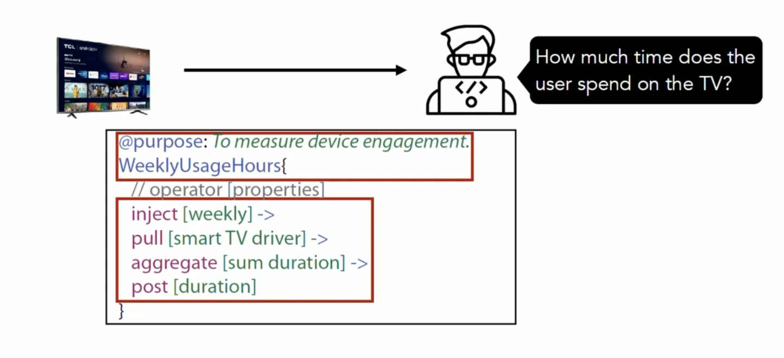
The first key idea of Peekaboo is text-based manifest
Notes:
To overcome the complexity of fine-grained permissions, Peekaboo proposes an alternative approach, requiring developers to declare the data collection behavior inside a text-based manifest. the text-based manifest describes how the app developer wants to like crack users data. Here the manifest is telling about the measuring the device management. Pulls the data weekly and aggregate it and send the results to the cloud.
App developers must declare all intended data collection behaviors in this manifest including under what conditions data will be sent outside of the home to cloud services, where that data is being sent to, and the granularity of the data itself.

Slide 6
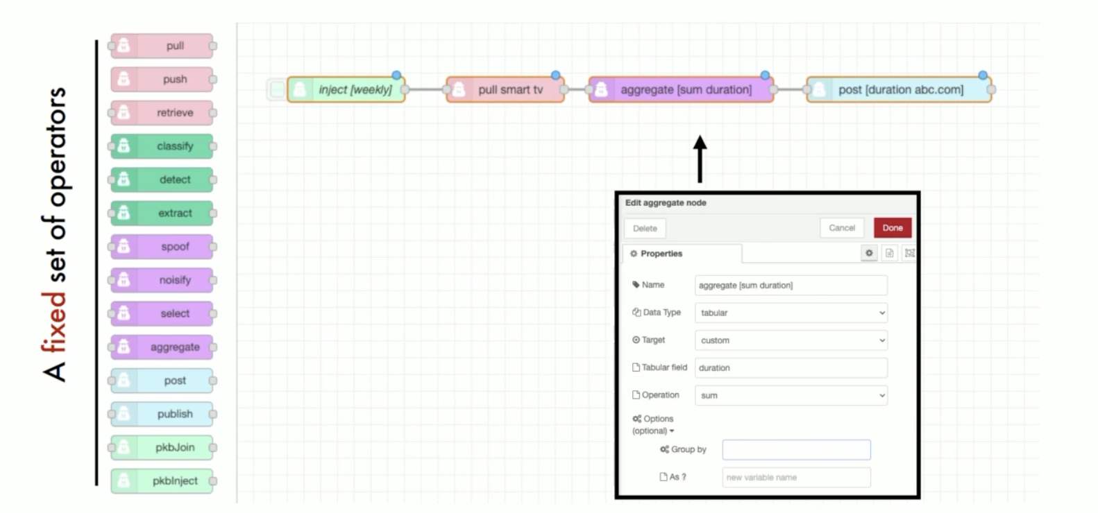
The second key idea of Peekaboo is its availability of pre-processing function for developers.
Peekaboo’s Programming Environment built in Peekaboo.
Peekaboo has a fixed set of pre-defined operators that allow developers to program the dataflow.
Notes:
the new way for developers to program pre-processing functions so it's instead of letting developers to write arbitrary code like python or c plus code the platform builders should offer a set of fixed set of operators and here each operator is a trainable data processing functions and the program is a stream oriented pipeline similar to unix pipes and the picture is a programming environment we build in peekaboo and here the app developer can drag the operators from left connect them into a pipeline and configure the properties of each operator

Slide 7
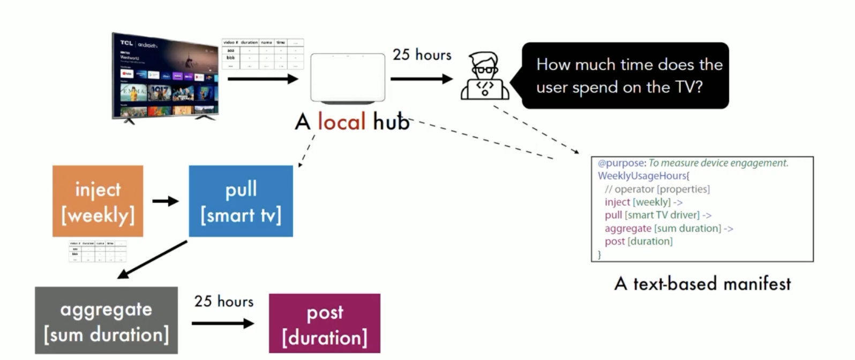
The third key idea of Peekaboo is a runtime with pre-loaded implementations. (TRUSTED)
Notes:
finally, a trusted local hub that mediate between the edge devices and the cloud servers. This hub enforces the declared behaviors in the manifests, and also locally runs all of the operators specified in these manifests to transform raw data before it is relayed to any cloud services.
Combined, these ideas make it so that developers can reduce data collection by running pre-processing tasks on the in-home trusted hub, and users and third-party auditors can inspect data behaviors by analyzing these manifests as well as any actual data flows. Our approach also facilitates a number of privacy features that can be supported by the hub itself, such as adding additional conditions or transformations before data flows out, or transforming parts of the manifest into natural language statements to make it easier for lay people to understand what data will be sent out, when, and to where.

Slide 8
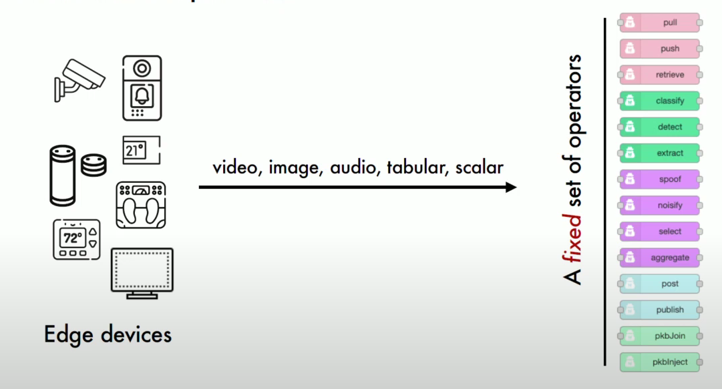
Design Overview
Collected 200 smart home use cases, grouped similar ones, analyzed what data they need, what are the constraints in using these data and then decided what must be the granularity of each data.
Segregated which use cases need entire raw data and which need only part of processed data(example derived brightness of the room for lighting app instead of image of entire room).
Based on the data transform behaviors, created sixteen operators grouped into five categories.
Notes:
three main components.
manifests : declare all data pre-processing pipelines
operators : fixed set of reusable and chainable operators to specify these pipelines
hub : in-home trusted hub that enforces these manifests and mediates access between edge devices and the wider Internet
Edge devices are basically heterogenous hardware with some kind of Device APIs. Developers create device drivers which wrap these APIs and prepare them into unified data model. Peekaboo has 5 types of data streams : video, image, audio, tabular and scalar value. Based on the data transform behaviors, created sixteen operators grouped into five categories. Most of the pre-processing functions share similar data actions. Means reusable operators.

Slide 9
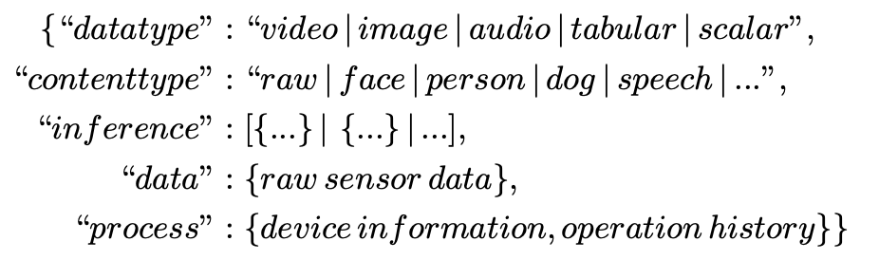
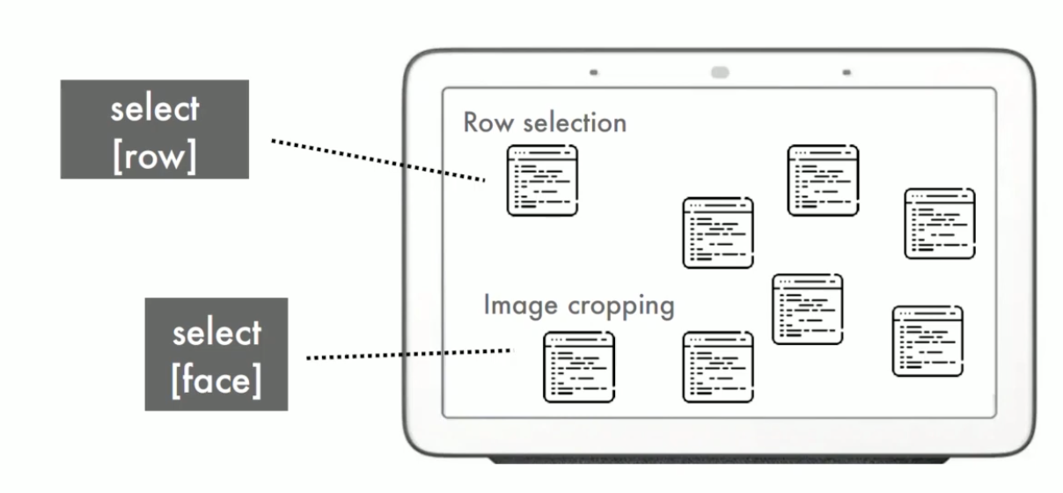
How does an operator work?
INSPIRATION: SQL Language
BEHAVIOR: An operator’s behavior is determined by the set of properties defined for the operator.
Peekaboo operators support an intrinsic condition flow control. The runtime executes an operator only if its input is ready, and the filter operators only forward non-empty processed data to subsequent operators.
Notes:
property of the select operator is row. The runtime will map the operator to the row selection implementation or if the property is face the runtime will map it to the image cropping one. Although there might be multiple implementation of the same operator, but the input and output semantics would be consistent because these semantics are determined by the verb like itself. The philosophy here is this simple and basic pre-processing functions can improve privacy a lot we only need to process the data into less privacy invasive format.
A Peekaboo data item only stores one unit of the data (e.g., an image, audio file, tabular row, or scalar value). Suppose the input of HelloVisitor is an image with multiple faces. Here, detect face will write multiple face annotations to the inference field, and each face annotation is a tabular Peekaboo data item. crop face will then generate a list of Peekaboo data items, where each corresponds to one face image

Slide 10
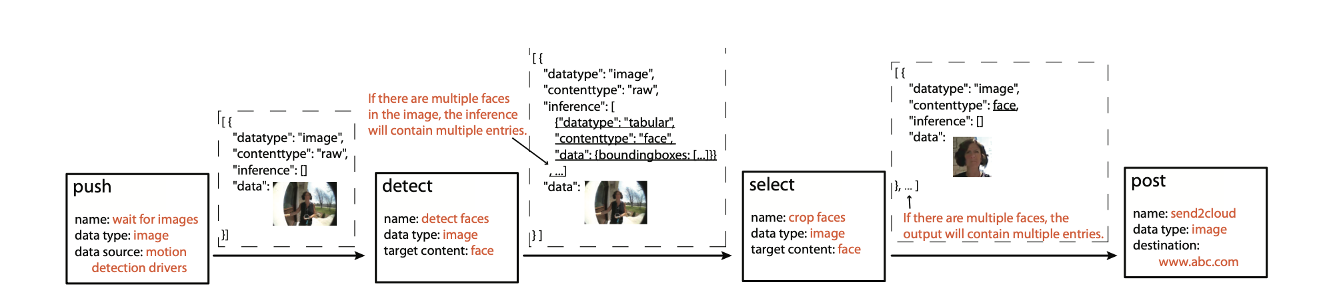
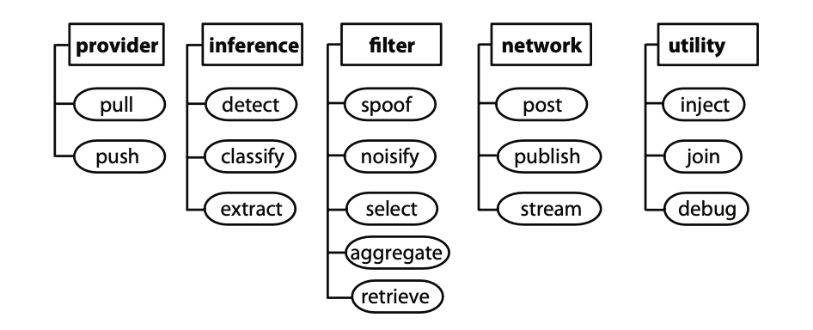
End-TO-End Flow
Notes:
Let's take an example to understand this better. Given here is a data pre-processing pipeline from the HelloVisitor app. When a user installs this app the HUB loads its manifest file and runs all the related operators.
Provider Operator:
push and pull represent two styles of data access: passively waiting for pushed data from drivers and actively pulling from drivers. For example, HelloVisitor starts with a push operator, When there is a significant change in the visual scene, hub sends image to trigger the operators.
Inference AND Filter Operators
when the app collects data (e.g., when a baby is crying) and what data content would be collected (e.g., face images, speech audios)
Hello Visitor : first uses a detect operator to annotate the bounding boxes of faces and then uses a select operator to crop the image.
Network Operators: Send data outside.
Operators are like abstract classes in object-oriented programming, The runtime then maps the manifest specification to the concrete subclass implementations based on the properties.

Slide 11
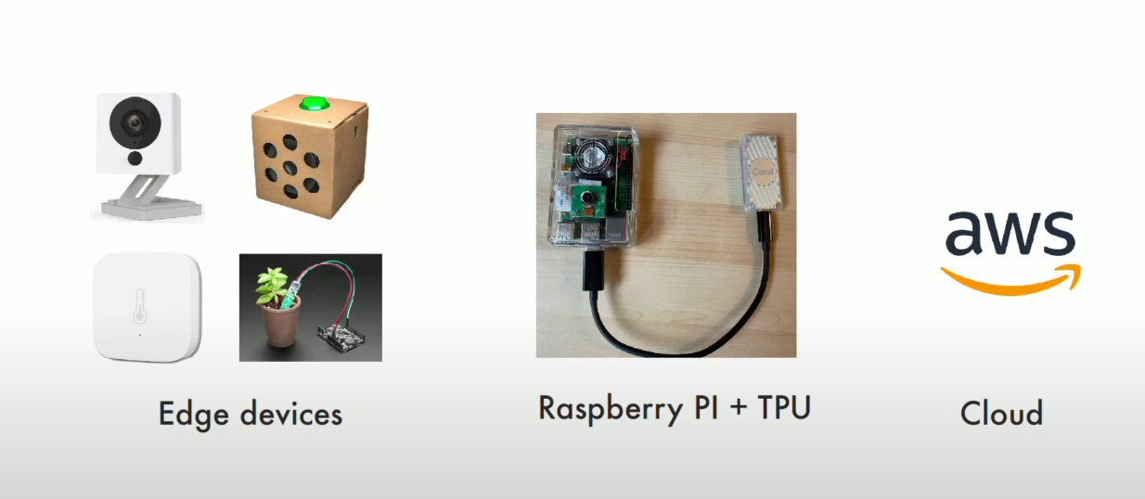
Implementation (Hardware)
Notes:
They have provided an end-to-end open-source prototype implementation of a Peekaboo using compatible home edge devices and hub built on 4 GB Raspberry Pi connected to a google TPU accelerator. Backend Services hosted on AWS.
To understand the range and limitations of its architecture, they implemented 68 different manifests to cover 200 use cases and analyzed the types of preprocessing in these manifests. They built five end-to-end Peekaboo apps, covering 5 data types (video, image, audio, tabular, and
scalar) and evaluated the scalability of Rasberry Pi setup, showing it can support more than 25 inference tasks and 100 filtering transformations per second.
*TPU: Application specific integrated circuits which accelerate the Machine Learning Workloads.

Slide 12
Implementation (Software)
Operators : Node.JS package
Programming IDE: NodeRed
Drivers: 5 Data types
23 Preloaded implementations
The source code is available at https://github.com/CMUChimpsLab/Peekaboo.
Notes:
1.Operators are implemented in Node.JS
2. Node-Red a visual programming platform developed by IBM.
3. Each Peekaboo hub program gets data from hub runtime drivers rather than querying hardware directly. These drivers retrieve raw sensor data (video, image, audio, tabular, or scalar).
(Downside of Javascript is lack of support for machine learning algorithms. Several ML inference algorithms are hosted in containerized services running on the Peekaboo hub, and only Peekaboo inference operators can communicate with these services locally through web sockets. )

Slide 13
Assumptions AND Benefits
Assumptions
Trusted hub
Hub can isolate IOT devices, data should flow only via hub and not circumvent.
Code of operators should be secure, made open source.
Benefits
TRANSPARENCY
EASE OF DEVELOPMENT
CENTRALIZED PRIVACY MANAGEMENT
Notes:
Assumptions 1--> The Peekaboo Hub, developed by platform providers (e.g., Apple,Google), is trusted and uncompromised.
2. IoT devices can be isolated by the hub, only allowing the whitelisted data flow from the hub through an independent or covert side channel.
3. operators: secure, no vulnerabilities, open source- verification audits
Transparency: The data minimization built here is blackbox to the outsiders. Even if the code is made open source, it is very difficult inspect actual data collection behavior
EASE OF DEVELOPMENT: Generally, data minimization algorithms and the user interfaces require more effort, however, Peekaboo’s built in features eases this.
CENTRALIZED PRIVACY MANAGEMENT: If the developers had to build the interfaces individually, it is hard to keep track. However, with peekaboo, a centralized management is available.

Slide 14
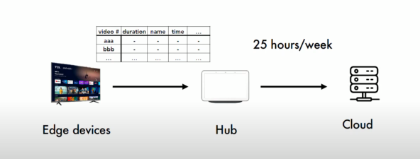
Peekaboo VS Firewall
Firewalls simply allow or deny the traffic request. Whereas Peekaboo pre-processes data to mitigate potential privacy risks.
Peekaboo is whitelist only system because IOT devices are much simpler and mostly do not require general purpose network access.
Notes:
We can think Peekaboo as a "Privacy Firewall".
Many IoT devices are expected to communicate with only a few remote servers known a priori, and so declaring the device’s behaviors allows the network to blacklist unknown traffic requests.
The key difference between a traditional firewall is that peekaboo is whitelist only system. The IoT devices are simple and do not require a general network access. Developers are in the loop. Instead of a firewall, the developers declare what data granularity is required and why.

Slide 15
Related work
PrivacyStreams is a framework for privacy-friendly personal data processing. It provides easy-to-use APIs in Android for accessing and processing various types of personal data. It focused on two challenges for accessing and processing personal data.
Privacy-sensitive Software Architecture: Various ideas have been proposed as alternatives Privacy-sensitive Architecture to avoid sending data to the cloud for processing.
Privacy Awareness and Control: In the case of IoT privacy, merely allowing or denying sensor access is insufficient and this all-or-nothing access control either exposes sensitive data or breaks the app functionality. Privacy support in these systems is often built on an individual basis with no common structure, imposing challenges.
Notes:
PrivacyStreams splits single-pipeline Android data processing into a number of reusable SQL-like operators (e.g., sortby, filter, groupby), which can make data processing more transparent. The key innovations of Peekaboo are the integrated designs and the demonstration of using a small and fixed set of operators to support a large number of data pre-processing scenarios. These two ideas allow Peekaboo to offer many features that PrivacyStreams cannot offer, such as OS-level enforcement, additional built-in privacy features, and explicit declarations of fine-grained data granularity.
The alternate approach is to process all sensor data at the “edge”, thereby avoiding sending data to the cloud. Another approach is to use trusted cloud computing and perform data minimization through technologies like DIY hosting, privacy-sensitive machine learning, and federated learning techniques. However, these approaches often come with tradeoffs such as sacrificing computational efficiency development flexibility or service quality. In contrast, Peekaboo offers a hybrid approach that does some pre-processing locally on the hub while also allowing developers to use cloud services in a manner that they are accustomed to.
Peekaboo addresses these needs through a novel privacy architecture, which can enable transparent and enforceable data collection, and offer centrally manageable hub privacy features.

Slide 16
Future Work and limitations
End-to-end encryption
More hub features
Manifests for other communication patterns
Operators are fixed.
Notes:
Peekaboo currently requires two separate encrypted connections (i.e., devices-to-hub and hub-to-servers) for its operation rather than end-to-end encryption from device to server directly.
The hub may aggregate the installed manifests, enable centralized privacy dashboards, and allow users to query what/when/how data flows out and allow users to apply global filters.
Currently focuses on whitelisting edge-to-cloud data flows, generalize the manifest for other communication patterns, such as device-todevice,cloud-to-device
Peekaboo runtime only supports a fixed set of operators and property options enabled by the pre-loaded implementations. We do not allow operators to be dynamically loaded because we would not know the semantics of that operator, and it may have undesired behaviors.

Slide 17
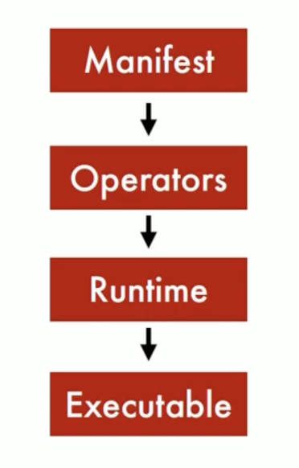
Conclusion
Latest IoT app development Framework.
Used by developers to build privacy-sensitive smart home apps.
The three key ideas that puts out Peekaboo’s Design :
factoring out repetitive data pre-processing tasks from the cloud side onto a user-controlled hub.
supporting the implementation of these tasks through a fixed set of open- source, reusable, and chainable operators
describing the data pre-processing pipelines in a text-based manifest file
Notes:
Peekaboo is a new type of domain specific language architecture whereas a manifest is a program and as operators zip became the language and at the runtime is a compiler that simply assembles this pack preloaded implementation like UNIX pipes. There are two important implications of peekaboo which is the computation there needs to be repetitive and we can absolutely abstract them into a fixed set of operators and only have a few preloaded implementations and we also need to build a trusted runtime.

Slide 18



THANK YOU

